Slide 1

Capstone Project North Wind Traders
By Sahil Bhardwaj

Slide 2
Topics
Project Overview
Information about Dataset tables
Data cleaning and MECE-Breakdown
Solving Power Bi and EDA Questions
Dashboard Analysis
Conclusion

Slide 3
Project overview
The North wind database contains the sales data for a fictitious company called “North wind traders” which imports and exports specialty foods from around the world. The report aims to generate insights into customer behavior, sales patterns, and employee performance to aid decision-making processes. It will cover sales analysis, customer segmentation, inventory trends, and employee performance, consolidating data from multiple tables for a comprehensive view of the company's operations. The objective of this report to empower stakeholders to make data-driven decisions by offering valuable insights and facilitating data exploration through interactive visualizations and dynamic filters.

Slide 4
Information about dataset table
Customers: This table contains information about customers, including their company details, contact information, and location.
Employees: This table stores employee details like name, title, contact information, and hire date. Orders: this table captures order details such as order ID, customer ID, date, items ordered, shipping information, and freight costs.
Order details: This table provides a breakdown of each order, including specific products ordered, their quantity, and unit price.
Products: This table showcases product information like name, category, unit price, stock levels, and supplier details. Suppliers: this table contains information about the company's suppliers, including their contact details and location.
Suppliers: This table contains information about the company's suppliers, including their contact details and location.
Shippers: This table lists the shipping companies utilized by north wind traders, along with their contact information.
Categories: This table categorizes the products offered by north wind traders.

Slide 5
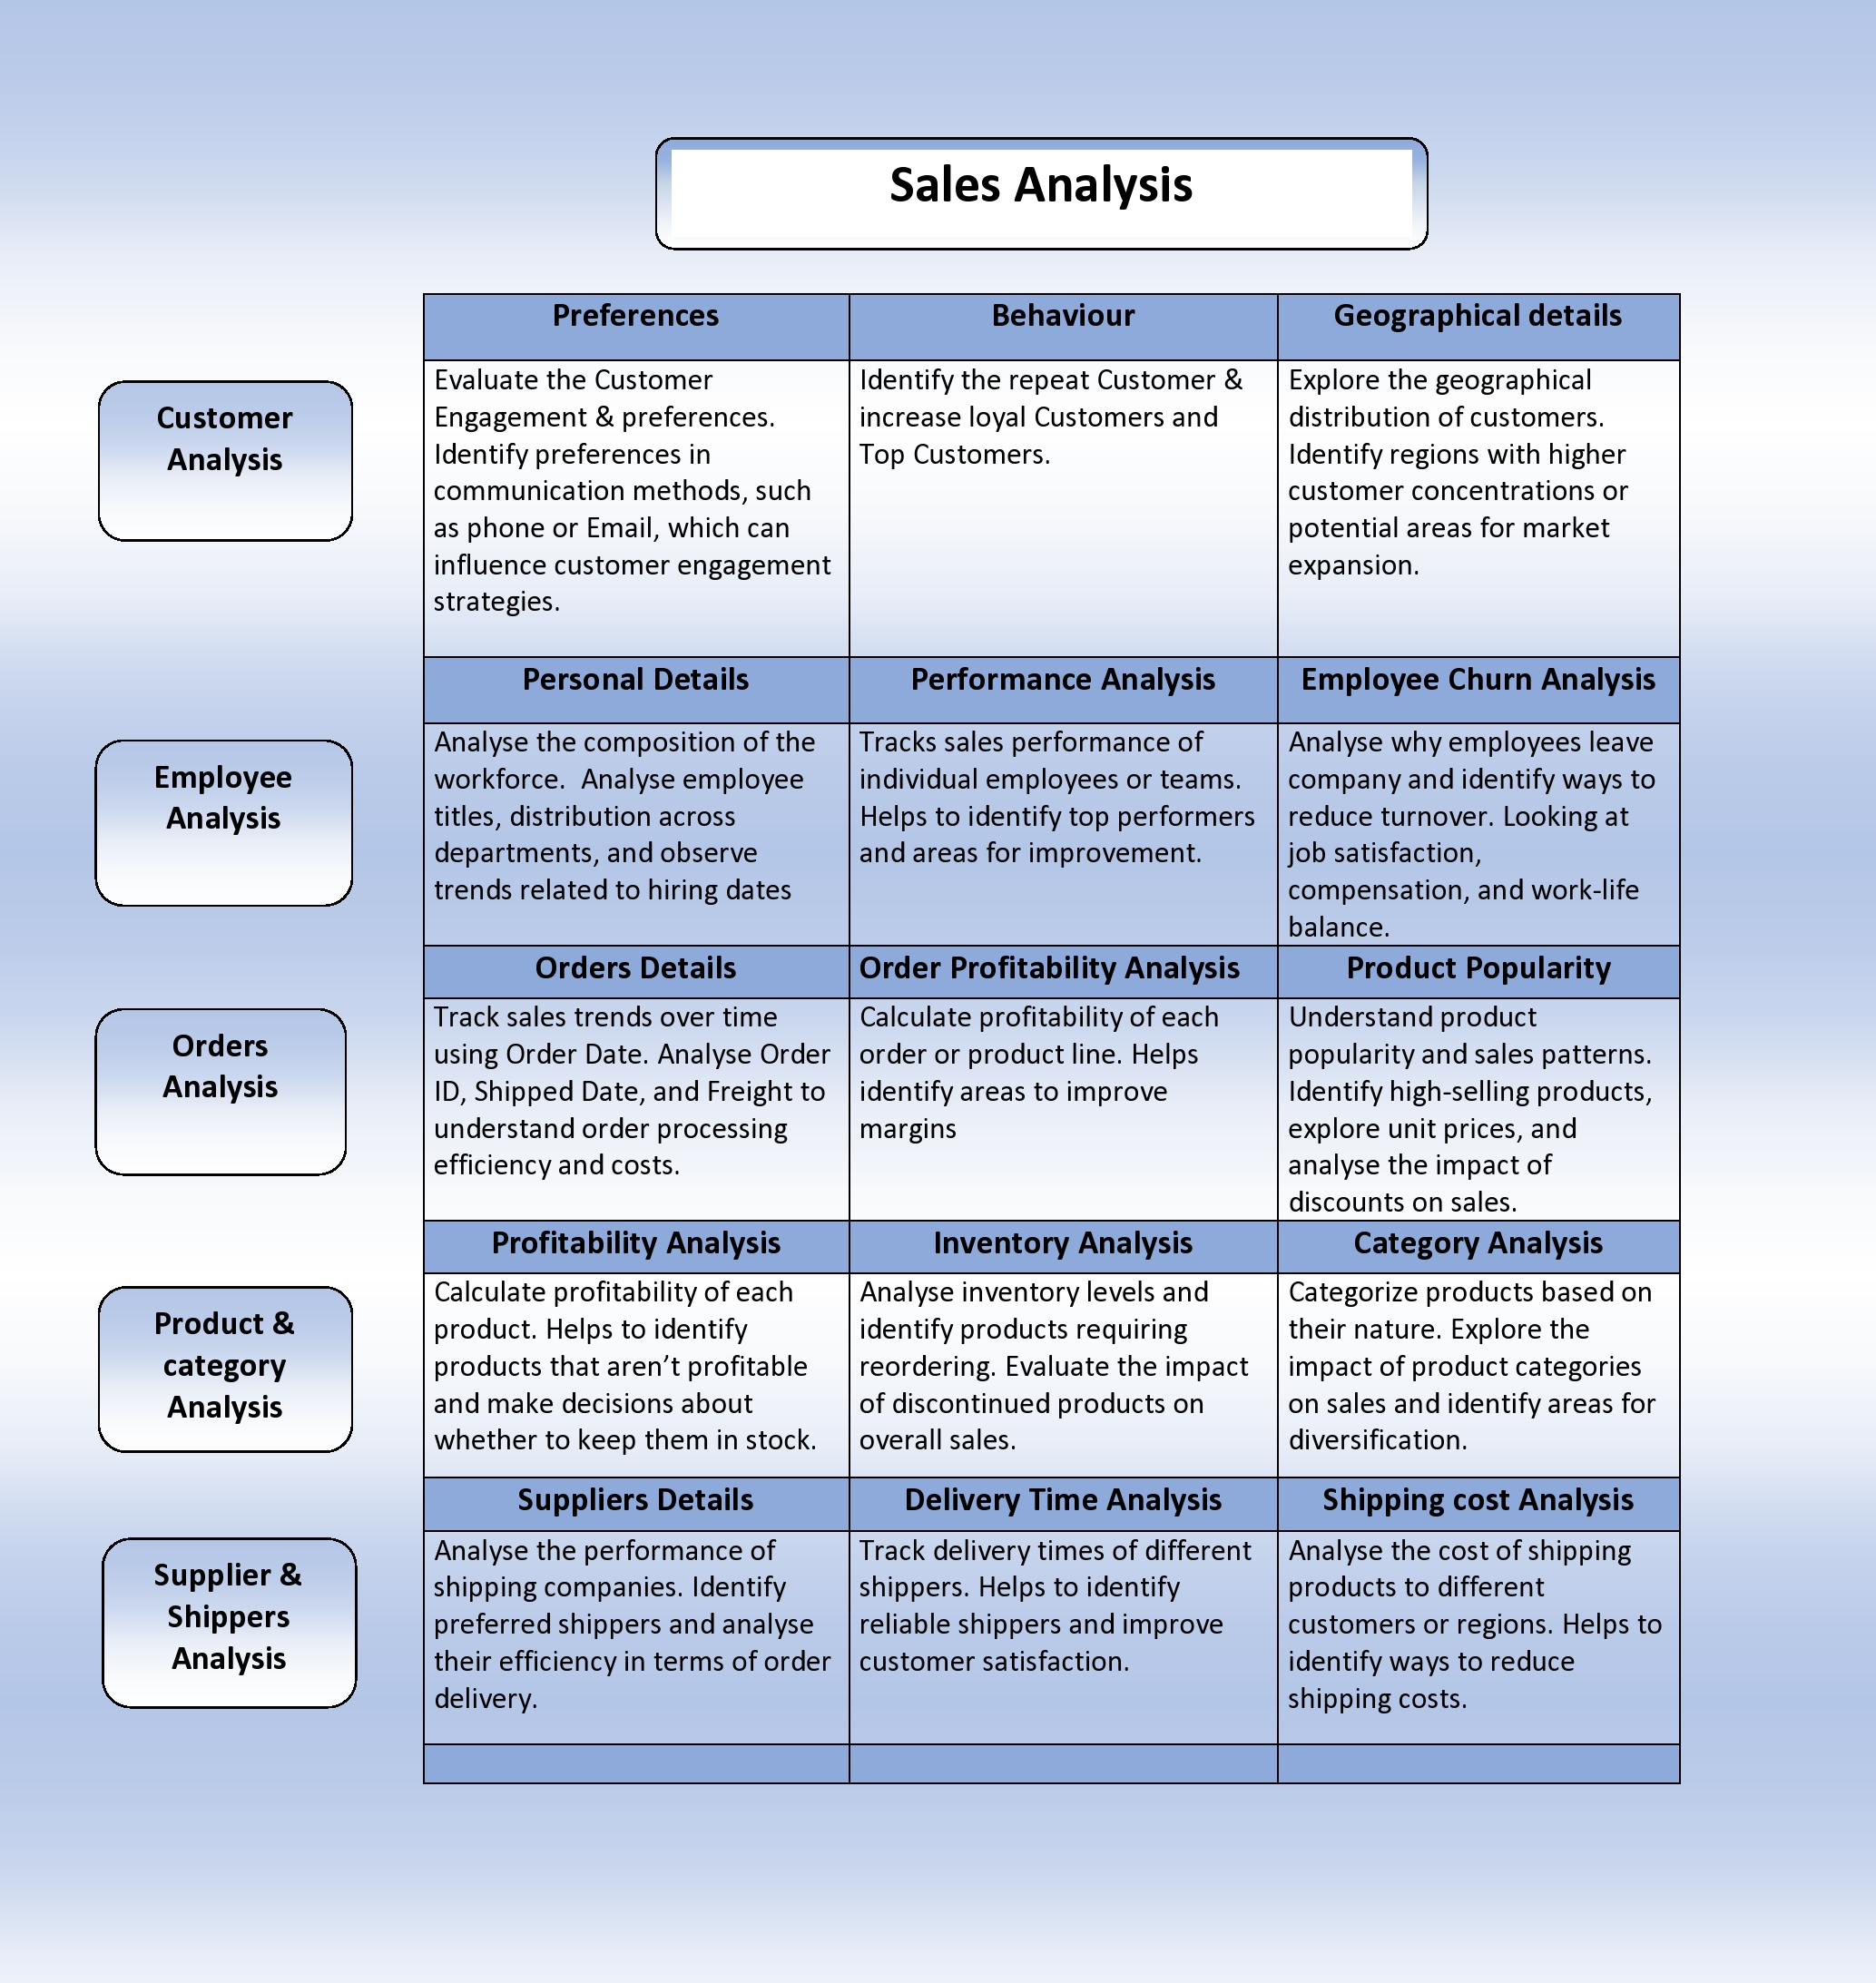
Data cleaning and MECE-breakdown
Data cleaning:
The Table contains many null value almost in each attributes ,Replaced each with N/A and remove those column that are not needed for visualization such as Fax ,Phone Number , Image , Image thumbnail etc. After transformation I have created a MECE-breakdown for better understanding of dataset.

Slide 6
Power BI Questions
How does customer distribution vary across different regions or customer segments? Can we visualize it on a map or bar chart?
What is the trend in customer acquisition over time? Can we create a line chart or area chart to display it?
Can we visualize the distribution of customer demographics such as age, gender, or income using histograms or pie charts?
How does order volume change over time? Can we create a time series chart or stacked bar chart to visualize it?
What is the distribution of order values? Can we create a histogram or box plot to display it?
Can we visualize the average order processing time or shipping duration using a bar chart or box plot?
How does employee productivity vary across different departments or job roles? Can we create a stacked bar chart or grouped column chart to visualize it?
What is the distribution of employee tenure? Can we create a histogram or box plot to display it?
Can we visualize employee performance ratings or KPIs using a radar chart or bullet graph?
What is the distribution of product ratings or reviews? Can we create a histogram or stacked bar chart to visualize it?
How does the sales volume vary across different product categories? Can we create a bar chart or tree map to display it?
Can we visualize the pricing distribution of products using a box plot or violin plot?
What is the distribution of supplier ratings or performance metrics? Can we create a bar chart or radar chart to visualize it?
How does the cost or pricing structure vary across different suppliers? Can we create a box plot or stacked bar chart to display it?
Can we visualize the geographical distribution of suppliers using a map or bubble chart?

Slide 7
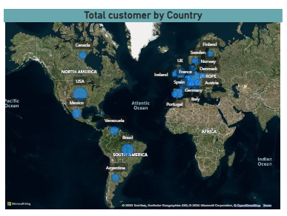
1.How does customer distribution vary across different regions or customer segments? Can we visualize it on a map or bar chart?
Yes , we can create a map for visualization of customer distribution across different countries . and also we can create a bar chart for it.

Slide 8
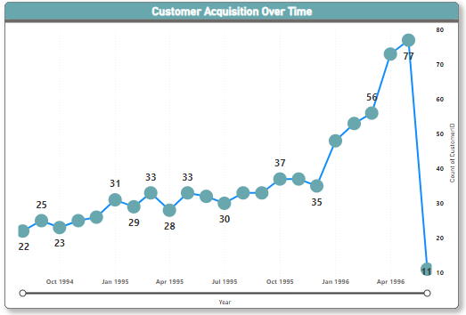
2. What is the trend in customer acquisition over time? Can we create a line chart or area chart to display it?
The customer acquisition trend is increasing over time, but with some fluctuations. There seems to be a steeper increase from October 1994 to April 1995, followed by a period of slower growth until June 1996.

Slide 9
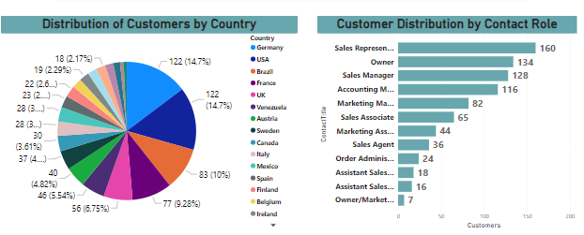
3.Can we visualize the distribution of customer demographics such as age, gender, or income using histograms or pie charts?
Distribution of Customers by Country:
A majority of customers around 60% are from Germany and the United States. The remaining customers are spread across various countries, with no other country exceeding 10%.
Customer Distribution by Contact Role:
The largest group of customers around 40% have the contact role of Sales Representative.
Other significant groups include Sales Manager around 14% and Accounting Manager around 10%.
Smaller groups include Sales Associate, Marketing Manager, Order Administrator, Assistant Sales, and Owner/Marketing.

Slide 10
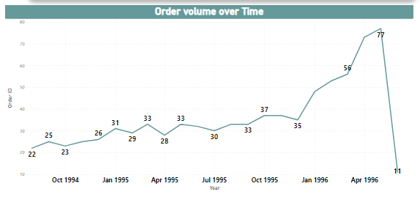
4.How does order volume change over time? Can we create a time series chart or stacked bar chart to visualize it?
The order volume shows a gradual increase over time, with some fluctuations. There's a notable jump in volume between July 1995 and April 1996

Slide 11
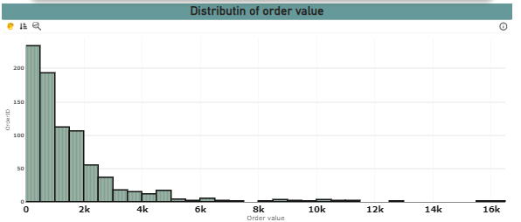
5.What is the distribution of order values? Can we create a histogram or box plot to display it?
Majority of orders have a low to moderate value. The peak of the distribution is concentrated around the $2,000-$4,000 range, suggesting a high number of orders fall within this price. While most orders are concentrated in the lower to mid-range, there's a noticeable tail extending towards higher order values, indicating a presence of some large orders potentially impacting overall revenue

Slide 12
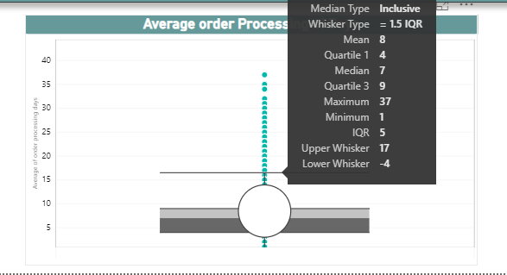
6.Can we visualize the average order processing time or shipping duration using a bar chart or box plot?
The x-axis shows whisker type, labeled 1.5 IQR. The y-axis shows average processing time in days. There are four horizontal lines representing quartiles and outliers. The median processing time is 7 days. The average processing time is 8 days. The whisker range is from -4 days to 17 days. There are two outliers, one at 37 days and one at 1 day.

Slide 13
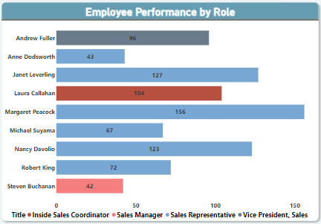
7.How does employee productivity vary across different departments or job roles? Can we create a stacked bar chart or grouped column chart to visualize it?
Sales representatives have the highest average productivity.
Most of orders are done by the sale representatives. Insider sales coordinator and vice president have done almost equal numbers of orders and sales manager have the lowest Productivity. There's a significant difference in productivity between the top and bottom roles

Slide 14
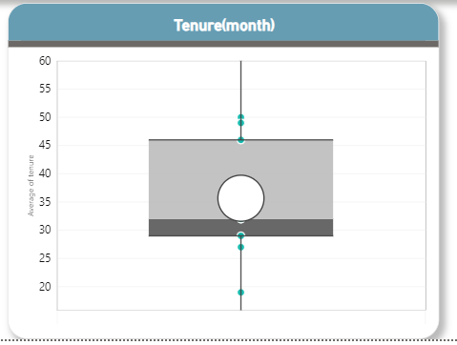
8. What is the distribution of employee tenure? Can we create a Histogram or box plot chart to display it?
Yes we can create a box plot for it . Majority tenure of employees have been with the company around between 29 and 46 Months.
Average Tenure of employees is 35.6.
Highest tenure of the employee is 50 month and lowest is 19 months .This indicate a presence of employees who have been with the company for a specific period of times.

Slide 15
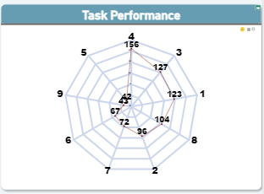
9.Can we visualize employee performance ratings or KPIs using a radar chart or bullet graph?
Yes , we can visualize it to check employee performance . Here employe ID 4 have done the highest task and lowest tasks done by Emp Id 5 (42 tasks )
This help us to identify the performance of the employees.

Slide 16
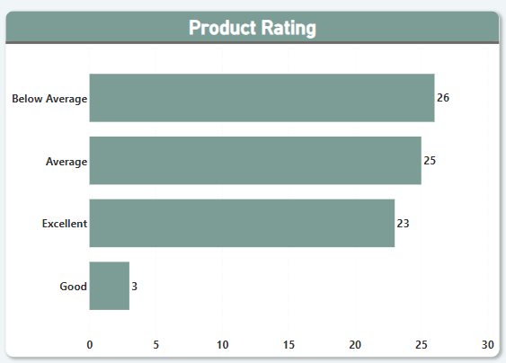
10.What is the distribution of product ratings or reviews? Can we create a histogram or stacked bar chart to visualize it?
Yes , we can create a stacked bar chart to check products performance by distributing them into a product rating . While the majority of products fall within the average and below average range, only a small percentage achieve "good" and "excellent" ratings. This signifies a potential opportunity to improve product quality or perception to increase customer satisfaction and positive feedback.

Slide 17
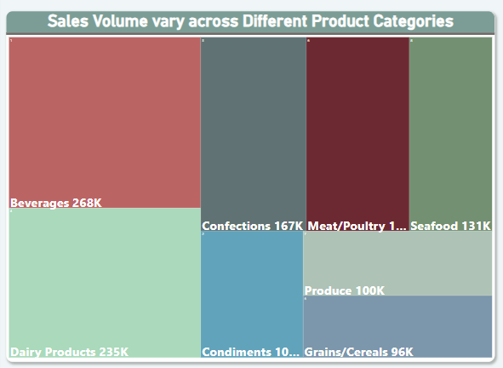
11. How does the sales volume vary across different product categories? Can we create a bar chart or tree map to display it?
Yes , we can create a tree map to check sales volume across the different Product categories.
Beverages and dairy products are the top sellers, generating significantly higher sales volume compared to other categories.
Confections, seafood, and meat/poultry show moderate sales volume, forming a middle tier and other categories show the lowest sales volume

Slide 18
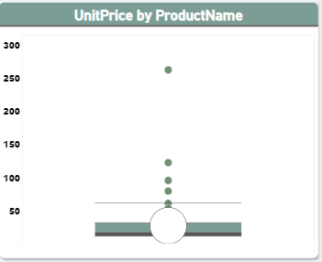
12. Can we visualize the pricing distribution of products using a box plot or violin plot?
Yes, we can visualize the price distribution of products using box plot .It help us to identify the outlier in the product price means which product have the highest price and lowest different from the average price of all the products .
The most of product price lie b/w
13 and 33 .The max price of the product is 263 and min price is 2.5 and the average of price of the product is 28.

Slide 19
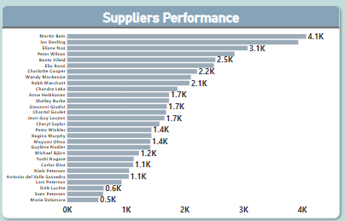
13.What is the distribution of supplier ratings or performance metrics? Can we create a bar chart or radar chart to visualize it?
Yes we can create a bar chart to visualize the distribution of supplier rating by check which supplier have highest no. of order quantity delivery. if the company buying product continuously then we can compare the supplier with there order quantity .
From the chart we can see that supplier martin Bei
have the highest order quantity.

Slide 20
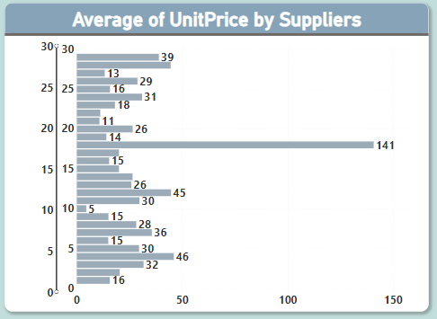
14.How does the cost or pricing structure vary across different suppliers? Can we create a box plot or stacked bar chart to display it?
Yes ,we can create a bar char to visualize the cost price structure vary across different suppliers by compare the average unit price provided by the suppliers .
This help us to check and compare the unit price of product by different Supplier to identity the which supplier is best for which product.

Slide 21
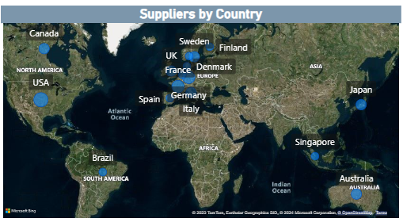
15.Can we visualize the geographical distribution of suppliers using a map or bubble chart?
Yes , we can visualize the geographical distribution of supplier by map chart .
This help us to identify the country and region of supplier and how many supplier in a each country

Slide 22
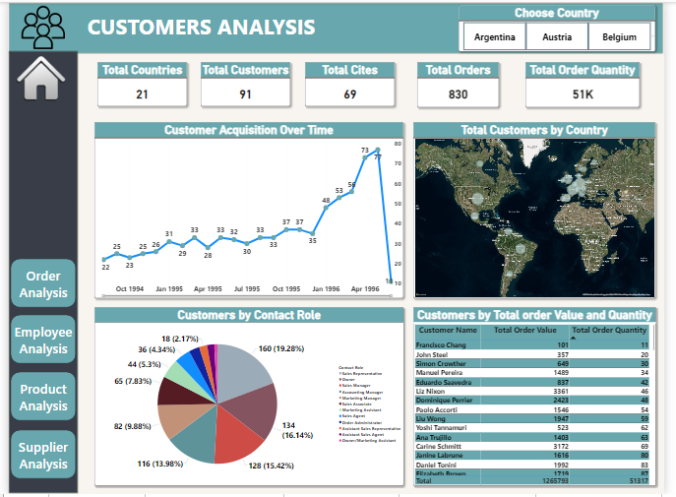
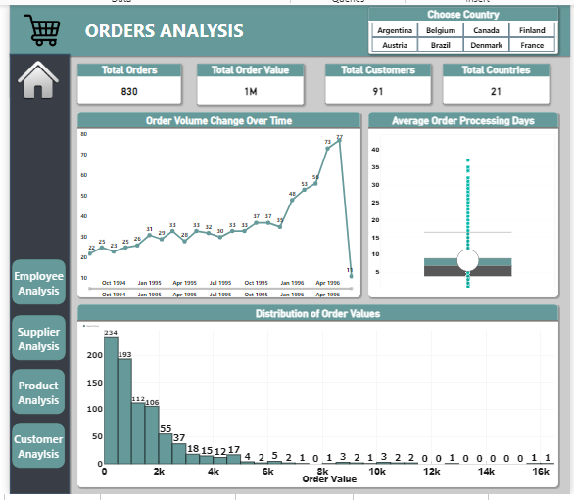
Customers Analysis
Orders Analysis

Slide 23
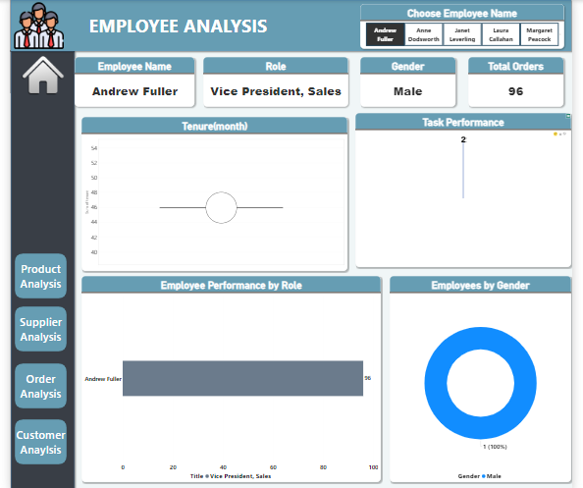
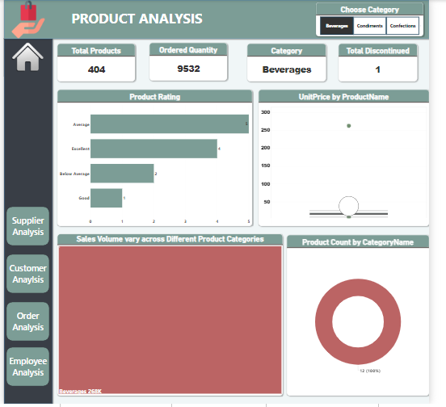
Employee Analysis
Product Analysis

Slide 24
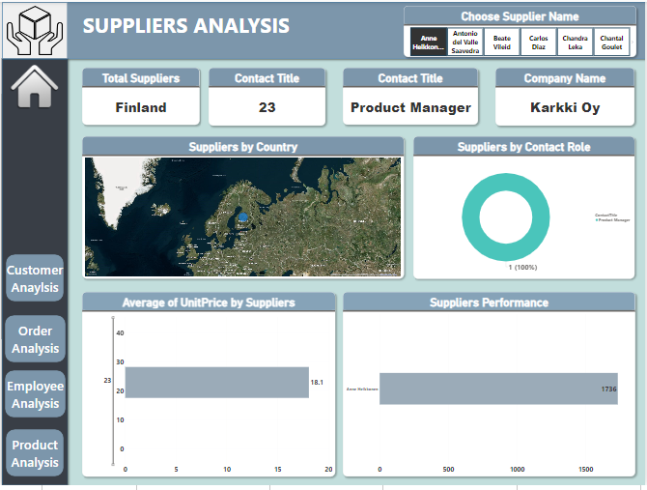
Supplier Analysis

Slide 25
EDA Questions
What are the key factors influencing customer retention or loyalty based on the dataset?
How do customer preferences vary based on their location or demographics? Can we explore this through interactive visualizations?
Are there any interesting patterns or clusters in customer behavior that can be visualized to identify potential market segments?
Are there any specific product categories or SKUs that contribute significantly to order revenue? Can we identify them through visualizations?
Are there any correlations between order size and customer demographics or product categories? Can we explore this visually using scatter plots or heatmaps?
How does order frequency vary across different customer segments? Can we visualize this using bar charts or tree maps ?
Are there any correlations between employee satisfaction levels and key performance indicators? Can we explore this visually through scatter plots or line charts?
How does employee turnover vary across different departments or job roles? Can we visualize this using bar charts or heatmaps?
Can we identify any patterns or clusters in employee skill sets or qualifications through visualizations? How can this information be used for talent management?
Are there any correlations between product attributes (e.g., size, color, features) and sales performance? Can we explore this visually using scatter plots or heatmaps?
How does product demand fluctuate over different seasons or months? Can we visualize this through line charts or area charts?
Can we identify any outliers or anomalies in product performance or sales using visualizations? How can this information be used for product optimization?
Are there any correlations between supplier attributes (e.g., location, size, industry) and performance metrics (e.g., on-time delivery, product quality)? Can we explore this visually through scatter plots or heatmaps?
How does supplier performance vary across different product categories or departments? Can we visualize this using stacked bar charts or grouped column charts?
Can we identify any trends or patterns in supplier costs or pricing structures through visualizations? How can this information be used for procurement optimization?

Slide 26
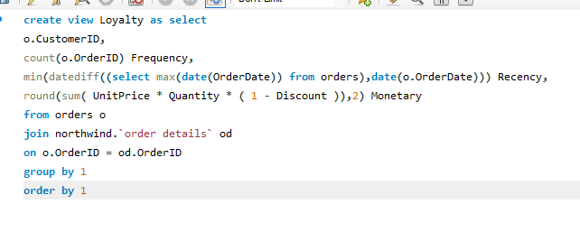
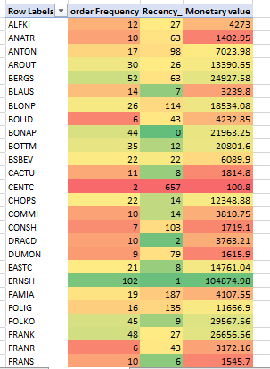
1.What are the key factors influencing customer retention or loyalty based on the dataset?
conclusion : This query calculates RFM values (Recency, Frequency, Monetary Value) for each customer, enabling segmentation based on their purchasing behavior . Recency show the number of days between the customer's latest purchase and a reference date, often the current date. It provides a straightforward understanding of how recently a customer has engaged in buying activity.
The most loyal customers:
SAVEA :This customer has the highest number of orders 116 and has spent the most money in total 104361.95 . They also placed an order recently within 5 days.
2. ERNSH: This customer has the highest number of orders 102 and has spent the most money in total 104874.98 . They also placed an order recently within 1 days. 3.RATTC: This customer has the highest number of orders 77 and has spent the most money in total 51097.8 . They also placed an order recently within 0 days. 4.QUICK: This customer has the highest number of orders 86 and has spent the most money in total 110277 . They also placed an order recently within 22 days. 5.BONAP: This customer has the highest number of orders 44 and has spent the most money in total 21963 . They also placed an order recently within 0days.

Slide 27
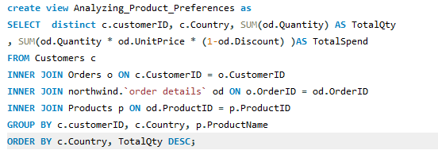
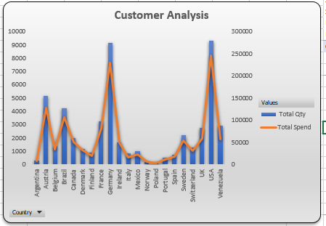
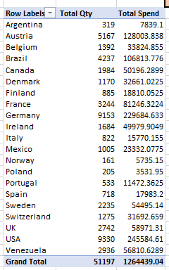
2.How do customer preferences vary based on their location or demographics? Can we explore this through interactive visualizations?
Customer Total spend and total Quantity in Each country
This query helps to check the total spend and Total Quantity purchased in each country .
By this we can identify the top country that contribute most in increasing the revenue.
USA have highest Total spend around $245584.

Slide 28
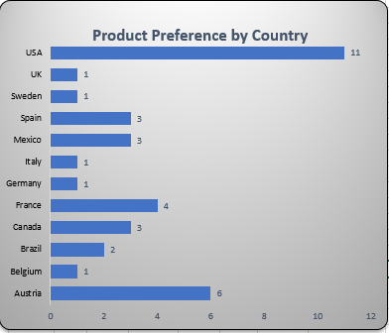
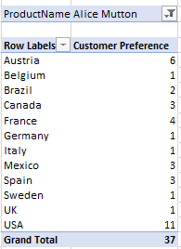
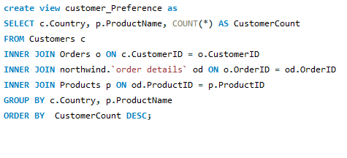
Total Customers for each Product in Different Countries
This query provides a list of countries and the top-selling product based on the number of unique customers who purchased it in each country. It focuses on customer preference rather than total quantity.

Slide 29
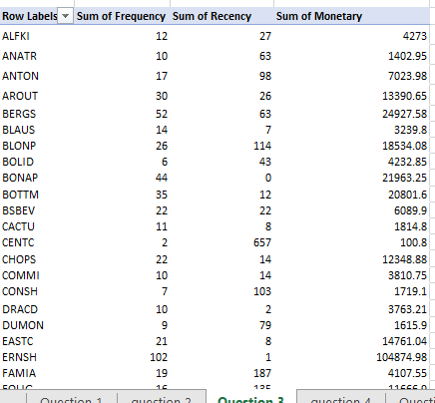
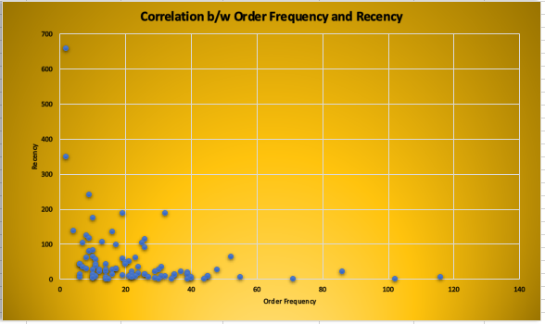
3.Are there any interesting patterns or clusters in customer behavior that can be visualized to identify potential market segments?
RFM Segmentation
This provide the Correlation b/w Recency and order Frequency of customer from this we can identify the customer behavior and purchasing pattern. Recency show the number of days between the customer's latest purchase . It provides a straightforward understanding of how recently a customer has engaged in buying activity.

Slide 30
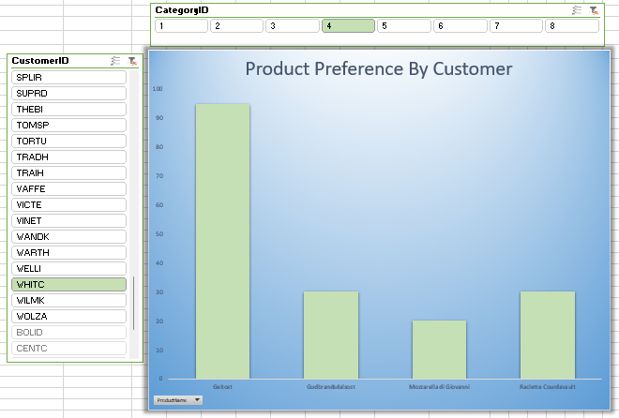
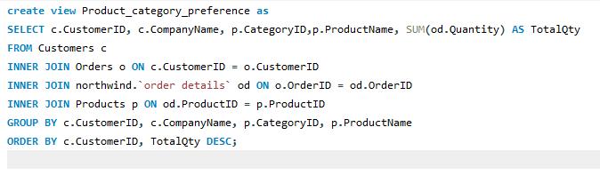
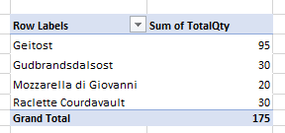
Product Preferences by customers
This query provide the preference of customer for different Category. This show that the each Customer Total Quantity From the each Product.

Slide 31
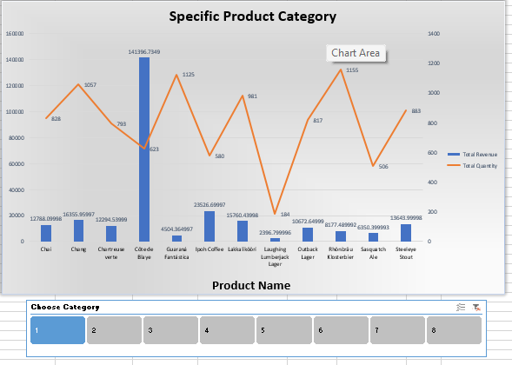
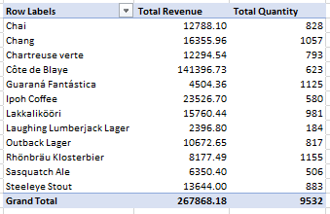
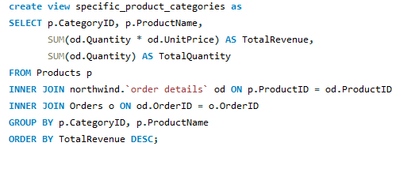
4.Are there any specific product categories or SKUs that contribute significantly to order revenue? Can we identify them through visualizations?
This provide total revenue and Total Quantity of each product for a specific category and in the chart secondary axis show the total Quantity and bar show the total revenue from each product.
This help us to compare the total sale of each product of different category.

Slide 32
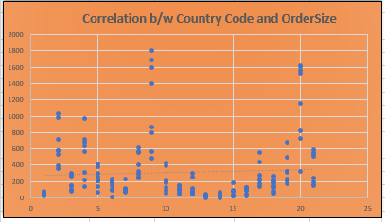
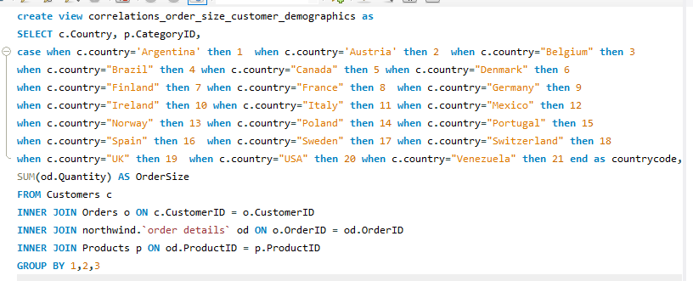
5.Are there any correlations between order size and customer demographics or product categories? Can we explore this visually using scatter plots or heatmaps?
The correlation coefficient between country code and order size is 0.0586.This indicates a very weak positive correlation. Based on this correlation, we cannot conclude that there's a significant relationship between country code and order size. Other factors are likely more influential in determining order size.

Slide 33
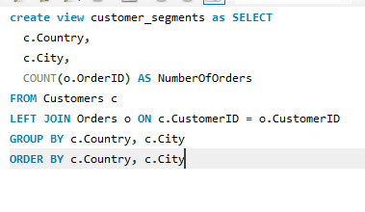
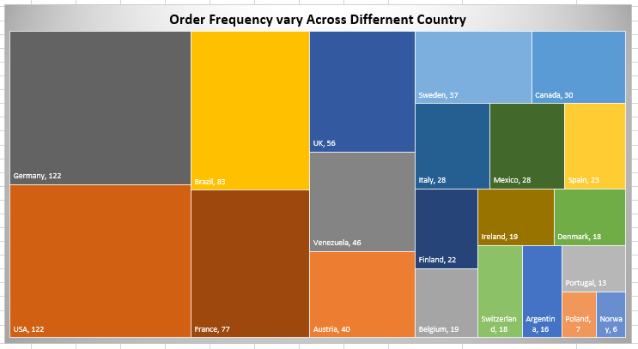
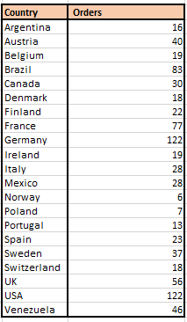
6. How does order frequency vary across different customer segments? Can we visualize this using bar charts or tree maps ?
The United States and Germany are the two countries with the most orders. This could be due to a number of factors, such as the size of the population, the level of economic development, or the popularity of the product or service being sold.
Some countries have relatively few orders. These include Portugal, Ireland, and Denmark.

Slide 34
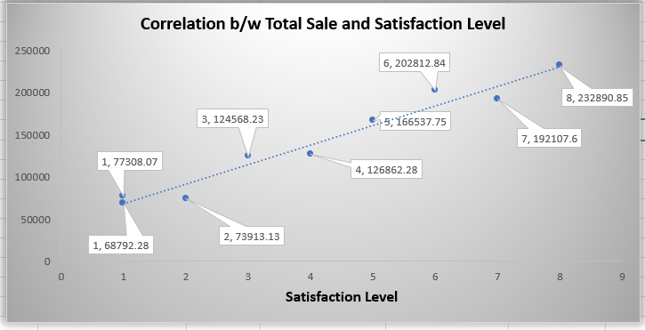
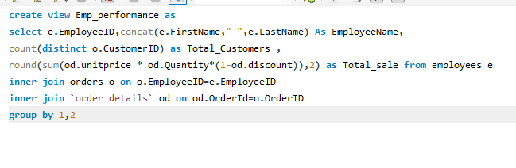
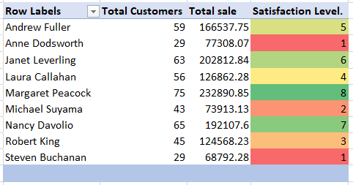
7. Are there any correlations between employee satisfaction levels and key performance indicators? Can we explore this visually through scatter plots or line charts?
The correlation b/w Total sale and satisfaction level is 0.0979 and this show the weak correlation .
Margaret Peacok (Employee ID 4) have most satisfaction level 8 and Total sale of 132890.85.

Slide 35
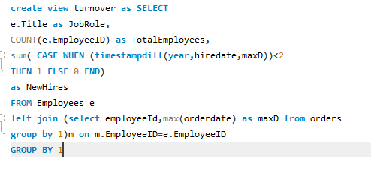
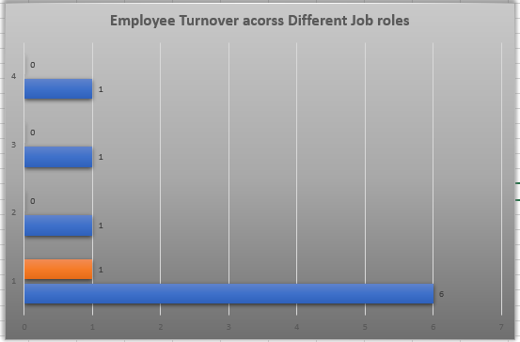
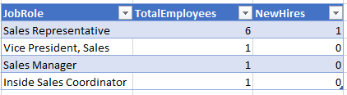
8. How does employee turnover vary across different departments or job roles? Can we visualize this using bar charts or heatmaps
This query provide last 2 year hire data and visualization provide a simple yet effective way to analyze employee turnover across different role. This data indicates that the Sales Representative role likely involves high employee turnover and ongoing hiring given the disproportionately large headcount compared to management positions.

Slide 36
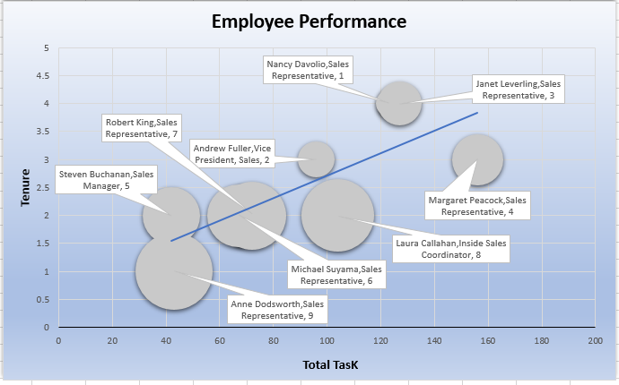
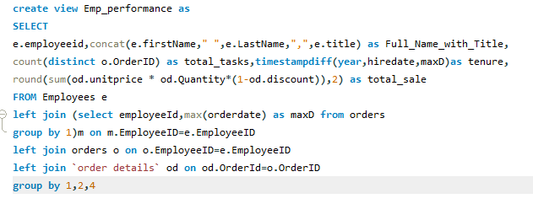

9. Can we identify any patterns or clusters in employee skill sets or qualifications through visualizations? How can this information be used for talent management?
The sales representatives seem to be performing well, with an average of 99.8 total tasks completed and an average of $160,153.06 in total sales.
Sales representative number 4 is the highest performing salesperson, with 156 tasks completed and $232,890.85 in total sales. Sales representatives number 1 and 3 are also high performers, with 123 and 127 tasks completed, and $192,107.60 and $202,812.84 in total sales, respectively.
However, there is some variability in performance, with sales representative number 9 completing only 43 tasks and generating $77,308.07 in total sales

Slide 37



10. Are there any correlations between product attributes (e.g., size, color, features) and sales performance? Can we explore this visually using scatter plots or heatmaps?
The data suggests that there is a Weak correlation between the number of units in stock and the total number of units sold. This means that more product units in stock tend to sell more units overall. This could be because these are more popular with customers, or because the store is not able to promote them more heavily.

Slide 38



11. How does product demand fluctuate over different seasons or months? Can we visualize this through line charts or area charts?
Overall demand increased in 1995: The total quantity of the product sold in 1995 (25,007) was almost three and a half times higher than the total quantity sold in 1994 (7,381). This suggests a significant increase in demand for the product over that period.
Demand fluctuated throughout the year: Even within years, demand fluctuated considerably. In 1994, December saw the highest demand (1,804 units), while August saw the lowest (1,462 units). This pattern is repeated in 1995, with November being the strongest month (2,657 units) and July being the weakest (1,635 units).

Slide 39




12.Can we identify any outliers or anomalies in product performance or sales using visualizations? How can this information be used for product optimization?
This give us visualization to identify outliers in sale performance of the products and we can also analyze product with Highest sales and lowest sales. From this we can compare the average price of the product with other for each category

Slide 40



13. Are there any correlations between supplier attributes (e.g., location, size, industry) and performance metrics (e.g., on-time delivery, product quality)? Can we explore this visually through scatter plots or heatmaps?
Correlation Coefficient (Contact Code vs. delivery Time):
The off-diagonal value of 0.001354 is the correlation coefficient between Contact Code and delivery Time . A correlation coefficient close to zero indicates a weak or negligible linear relationship between the two variables. In this case, the correlation coefficient is negative, but the magnitude is very small.

Slide 41


Correlation Between Ship Country/Country code and Delivery Time
Correlation Coefficient (country code vs delivery time) is 0.01319.
The positive sign indicates a positive correlation between country code and delivery Time. However, the correlation coefficient is relatively small , suggesting a weak positive linear relationship

Slide 42



14. How does supplier performance vary across different product categories or departments? Can we visualize this using stacked bar charts or grouped column charts?
This query provide the supplier ID ,contact tile, category name ,total Unit on order, average delivery time by suppliers . For Category Beverages total unit on order is 1760 and average delivery time by the supplier id 1 is 27 days and supplier id 2 provide average deliver time of 28 for 390 total unit on order and supplier id 20 provide average deliver time of 28.5 days for 280 units . By this we can compare the average delivery time provide by the suppliers to check the supplier performance for different category and Job Roles.

Slide 43



15. Can we identify any trends or patterns in supplier costs or pricing structures through visualizations? How can this information be used for procurement optimization?
Suppliers with higher vs lower average pricing overall.
Categories where certain suppliers have exceptionally high prices.
Comparing pricing between suppliers for the same category . Based on Analysis: Negotiate lower pricing in categories where a supplier's prices are consistently high Switch suppliers for certain categories to reduce costs.

Slide 44
Conclusion:
By providing a visually compelling and user-friendly dashboard with interactive features, this Power BI report empowers stakeholders at Northwind Traders to make data-driven decisions. This comprehensive analysis of customers, sales, inventory, and employees offers valuable insights into business operations and facilitates data exploration. The expected impact is a transformation in how Northwind interacts with its data, ultimately enhancing competitiveness and driving the company forward in the wholesale market.

